Slide 1

EXERCISES
Mississippi Office of Homeland Security

Slide 2
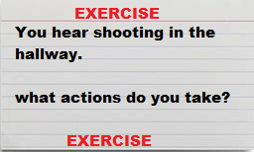
Simple to Complex
Simple:
  Index Card Exercise: Test individual knowledge of a given scenario.

Slide 3
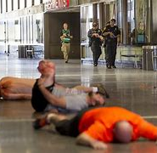
Complex
Full-Scale Exercise: Everyone Participates, law enforcement, Fire , EMS/Hospitals, Life Flight. You physically do every aspect of a real response.
These you build up to.

Slide 4
Types of Exercises ( Your building blocks)
Seminars: Gain awareness of interagency capabilities.
  Community based. Learning what each other provide.
Workshops: Plan Development.
  Building the foundation of your plan.
Tabletops: Identify GAPS.
  Show if the plan works.
Games: Simulation that promotes critical thinking.
  Helps staff work through problems of task they may be asked to perform.
Drills: Operations bases to validate an operation or function.
  Aids in testing basic functions, such as lockdowns/evacuations/fire drills.
Functional: Realistic capabilities evaluation.
  Test on a particular function, LE response, Wounded Evacuation or Reunification set-up
Full Scale: Complex real time operational based test of capabilities, resources and multi-agency involvement.
  TEST everything as if was real-world.

Slide 5


