Slide 1
Active Shooter Table-Top Exercise
Presented by
The
Mississippi Office of Homeland Security

Slide 2
AGENDA
Why Table-Top Exercises?
Conducting a Table-Top Exercise
Mock Table-Top Exercise.

Slide 3
Exercises are a tool
Exercises can be used for numerous scenarios to look at individual functions or as a total scenario driven exercises to look at how your plan works.
Conducting Table-Tops first will ensure that drills, functional and full-scale exercises work.

Slide 4
Participation in the exercise
There are no golden answers.
Take the scenario based on the information given and your knowledge of available assets and plans.
Our mission is to evaluate based on reality.
Ask questions.

Slide 5
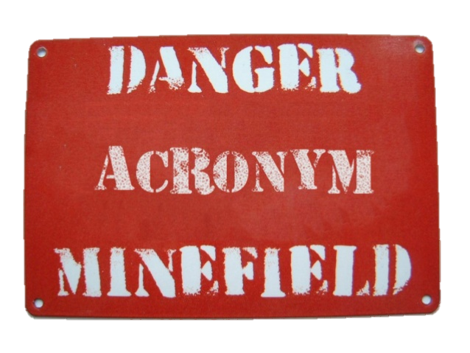
Exercise Rules
Stress-Free Environment, Safe
Active participation is encouraged
Respond based on current plans and capabilities
Use “clear voice”… FYI, acronyms and jargon may not be familiar to all players/stakeholders
Don’t become over-involved in the scenario

Slide 6
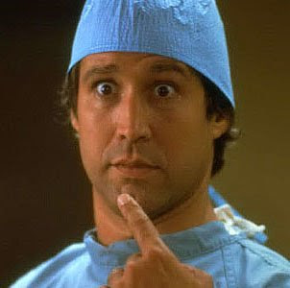
What Exercise is Not.
This type exercise is designed to verbally test your capabilities in the given scenario… This IS NOT a finger pointing contest!!!
The
Goal is to identify gaps and opportunities.

Slide 7
Testing Emergency Functions
Simulated response actions should be from existing plans and/or procedures
Don’t view the exercise a pass or fail event, it is an opportunity to recognize gaps in plans during a simulated event rather than in a real-life event
The fact that you are all here today shows a proactive trajectory

Slide 8
What are you testing
Alert/Notification (Officials and response/recovery personnel)
Warning (staff, visitors and public, in particular Special Needs population)
Command and Control and Communications (Operational command and Communications between multi-agencies)
Coordination and Control
Emergency Public Information
Media
Families
Health and Medical (Continuity of Operations)
Speed of Scene Security
Triage
Transport capabilities for multiple Victims.
Patient Tracking
Public Safety (Scene Security)
Accountability
Re-unification

Slide 9
START THE EXERCISE

Slide 10
Set-up
October 2022
0915 hrs.
Temperature is 65 degrees and overcast.
Just a typical day in Mississippi.

Slide 11
Any Campus in Mississippi

Slide 12
Scenario Begins : 0915hrs.
Notes:
If you hear gunshots or some thing that could be gunshots, go straight to deliberation.
Ask yourself how often do you hear something like fireworks at work? For most people it is never

Slide 13
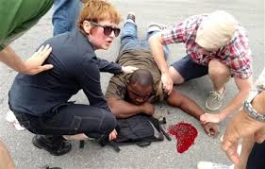
911 Call
0916 Hrs. A caller calls 911 and reports he heard gunshots, in the vicinity of building 1 and he believes someone has been shot.

Slide 14
Scenario
Another report to 911, caller states they heard what sounds like guns shots being fired and people screaming coming from building 1.
Some people in nearby area begin to panic.

Slide 15
Discussion
What actions are we taking at this point?
Alert and Notification
How do we Alert?
What if that system fails?
Who do we notify?
What do we say?
Will our faculty perform as trained?

Slide 16
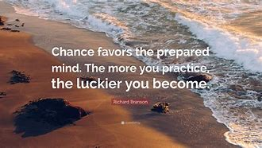

Slide 17
Lockdown
Are their actions administrators can take while lockdown?
PREPARE:
What comes next?
Start thinking ahead!

Slide 18
What is your school doing now!
Based on the information given.
What are your immediate actions?
What are your primary concerns?
Are we establishing Command and Control currently?
Who's talking to who?
Where can we operate?

Slide 19
Scenario
0916 hrs. Gun man begins moving down hallways.
Gunman is reported as a white male between the ages of 30-35 years of age. Bald black shirt, blue jeans carrying what appears to be a shotgun and a handgun.
Those that heard the shots have secured themselves in available rooms and others are running.
What actions are we taking?

Slide 20
Following our plans
A lot of time in our plans we put the WHAT.
But the life changing part is HOW we accomplish these task.
HOW
Will we contact others?
We make notifications?
Will we conduct lockdown procedures?

Slide 21
How are we doing things….
HOW more than the What………
Respond to the shooter…. HOW?
Communicate the threat…. HOW?
Go into campus lock Down…. HOW?

Slide 22
0918hrs. First Arriving law Enforcement Unit On Scene

Slide 23
Discussion
How well do your local first responders know your schools?
Have they conducted walk throughs?
Have they exercised there?
How often?

Slide 24
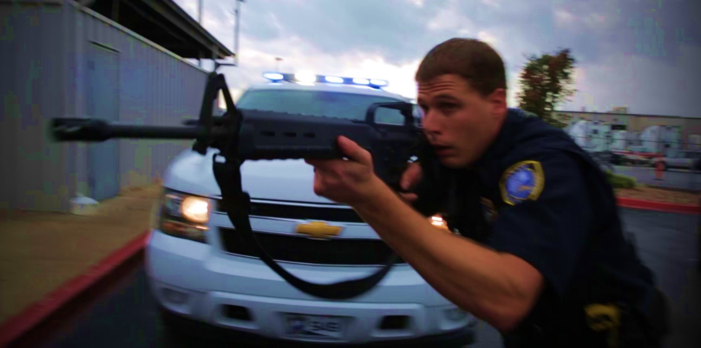
Law Enforcement Actions
1. Stop the Killing.
2. Stop the Dying.
3. Evacuate Wounded.
4. Secure Scene.
5. Other Duties.

Slide 25
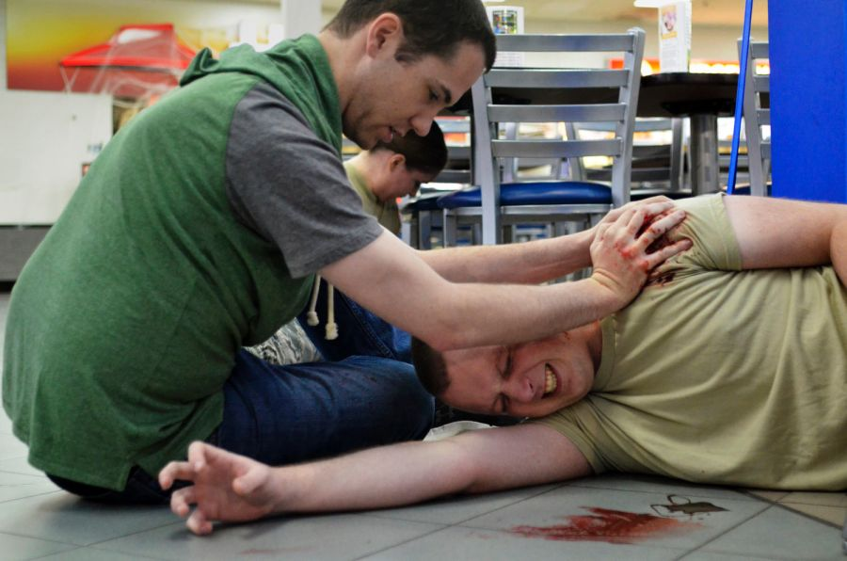
Scenario
Some students and teachers were walking down the hallway when the gunman came into the hallway.
Multiple individuals are believed to be injured and lay bleeding on the floor.
Screams and cries can be heard.

Slide 26
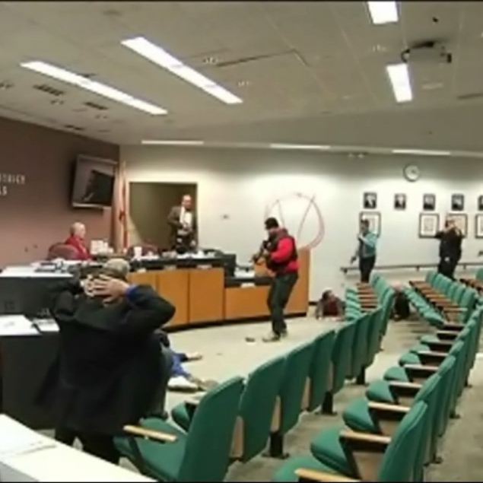
0919hrs
The first arriving officer, locates and neutralizes the gunman.
First arriving officer radios that a suspect is down and begins ensuring that area is secure and assessing possible wounded.

Slide 27
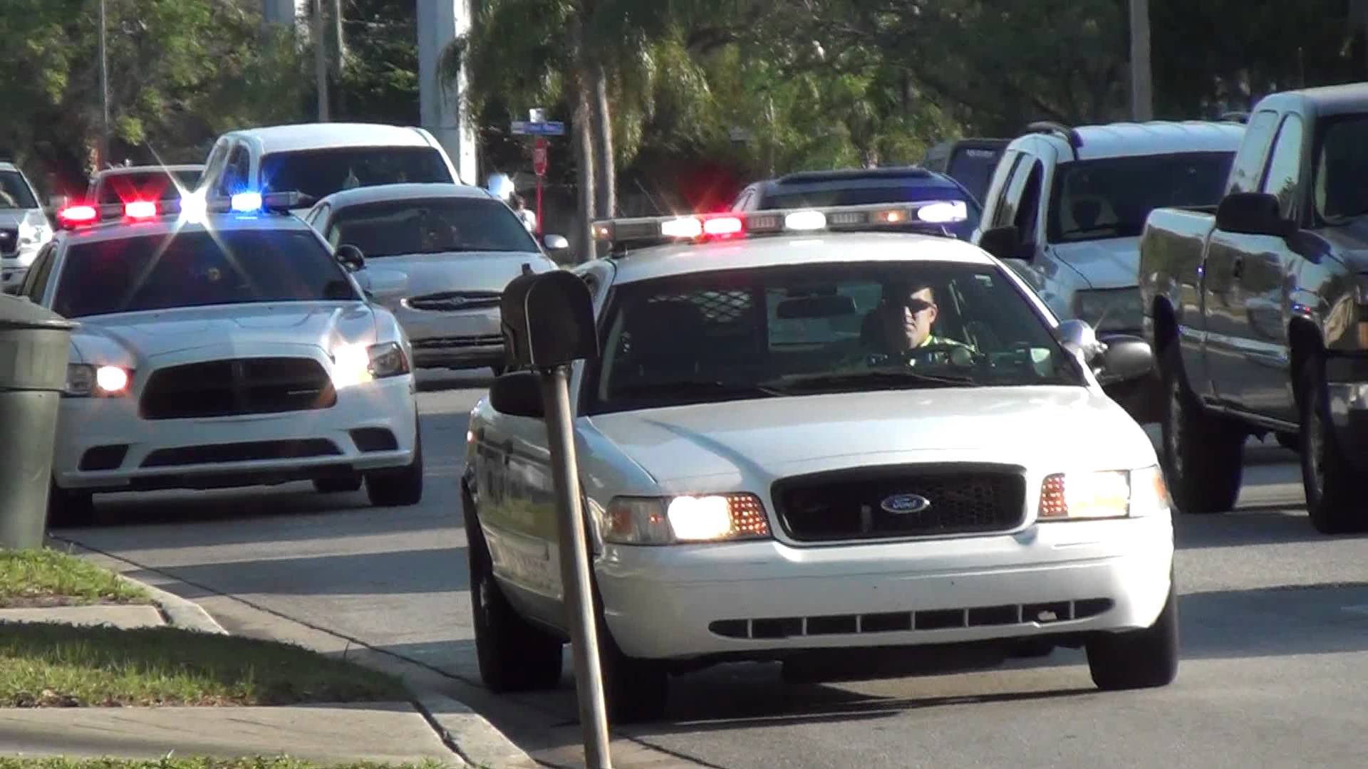
Additional arriving units

Slide 28
Dealing with the wounded

Slide 29
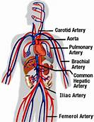
Discussion
Do your faculty members know how to treat a wounded child in their classroom?
BLEED CONTROL

Slide 30
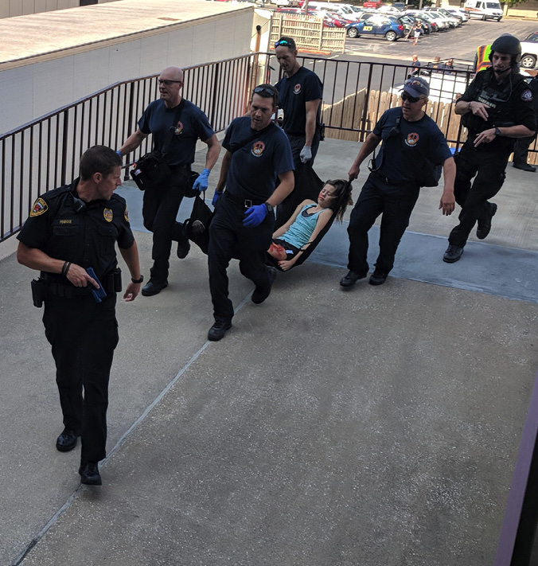
Assessing and Evacuating the wounded

Slide 31
Triage

Slide 32
Additional units begin Searching

Slide 33
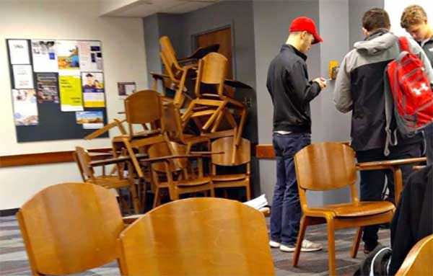
Staff and Students still secured in place.

Slide 34
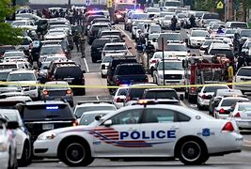
Other Issues of the response
Traffic control.
Open Lanes.
Scene control.
How this affects your operations.

Slide 35
As we clear the buildings
Should we get decisions makers first?
Principal
Asst. Principal
Other staff.

Slide 36
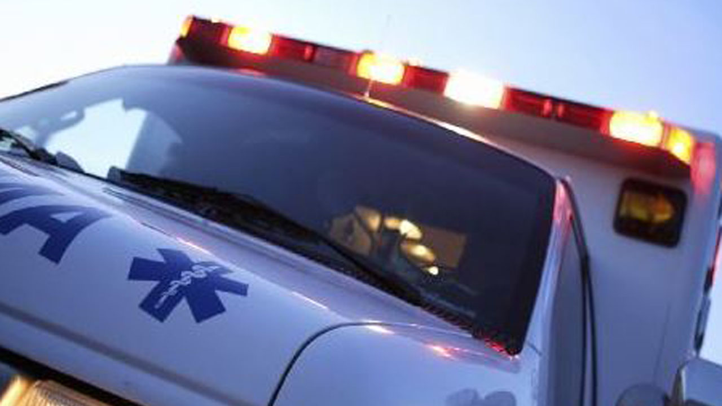
Emergency Medical Assets

Slide 37
Thoughts
How Many Ambulances are on duty on a normal day in your county?
How many medically trained personnel are there in your county?
How many patients can your ER take?

Slide 38
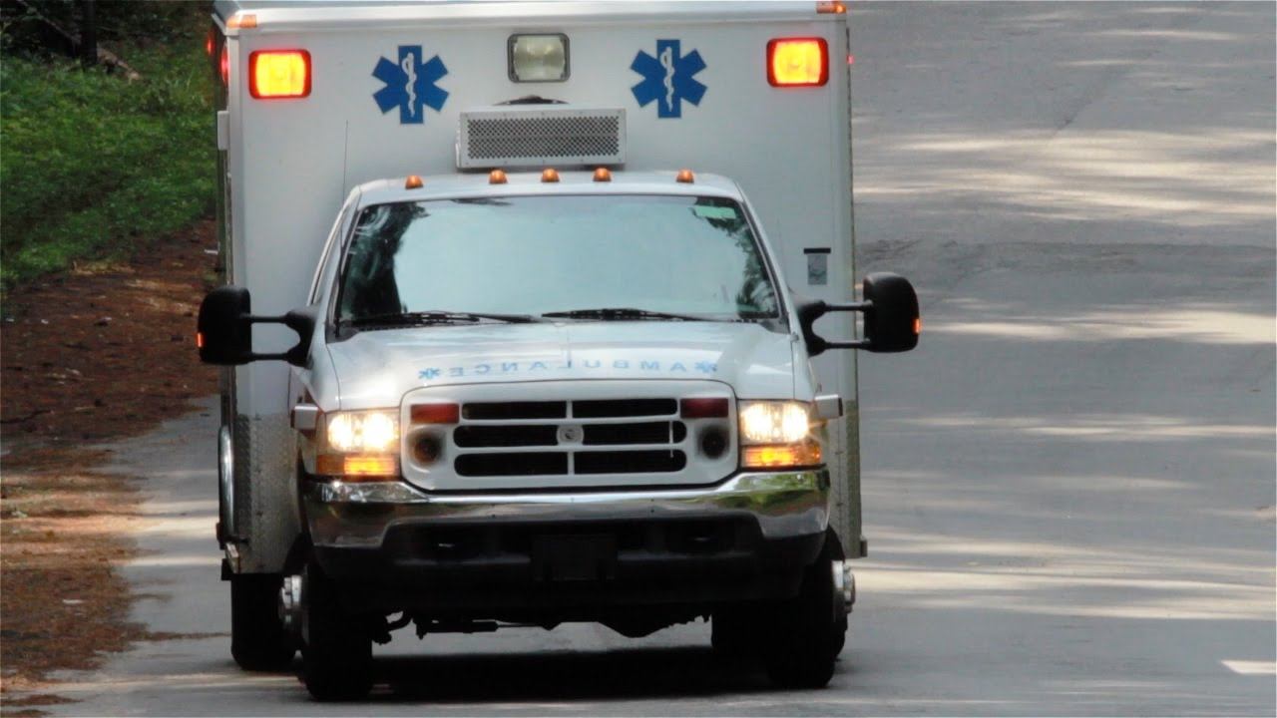
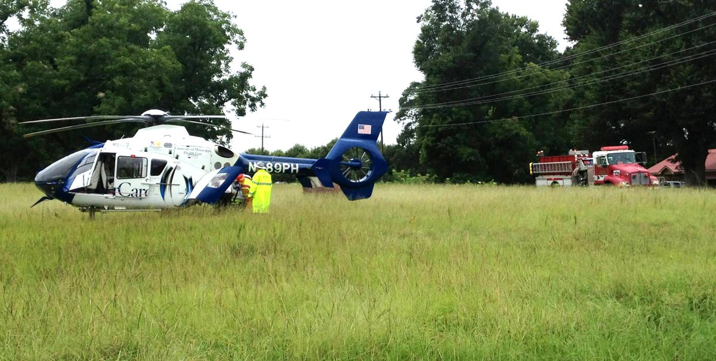
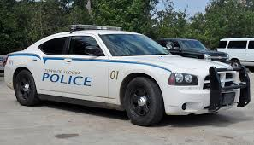
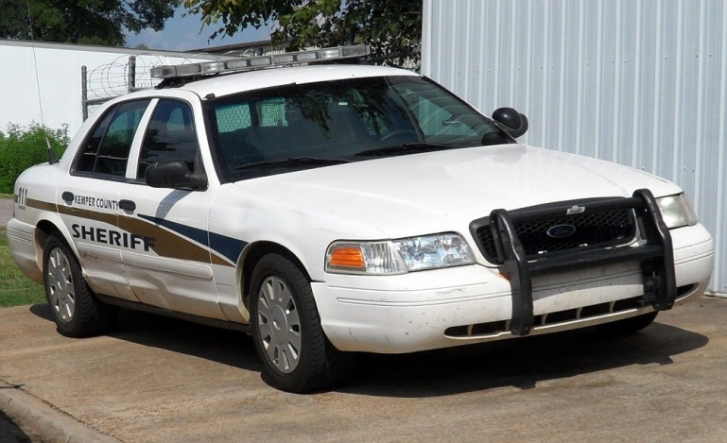
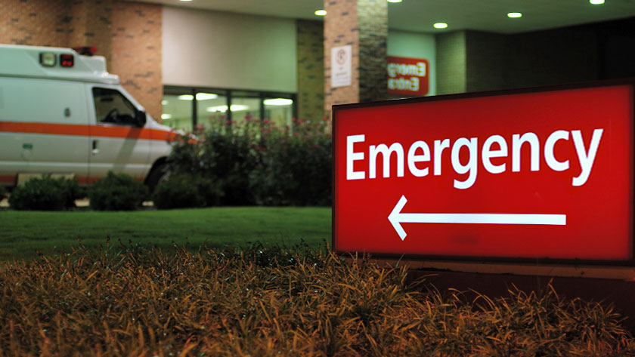
TRANSPORTING

Slide 39
Accountability
How do you maintain student accountability in all this chaos?
Taking roll call.
Establishing communication.
Liaison
Work with IC.

Slide 40
What does the school district need to be concerned with?

Slide 41
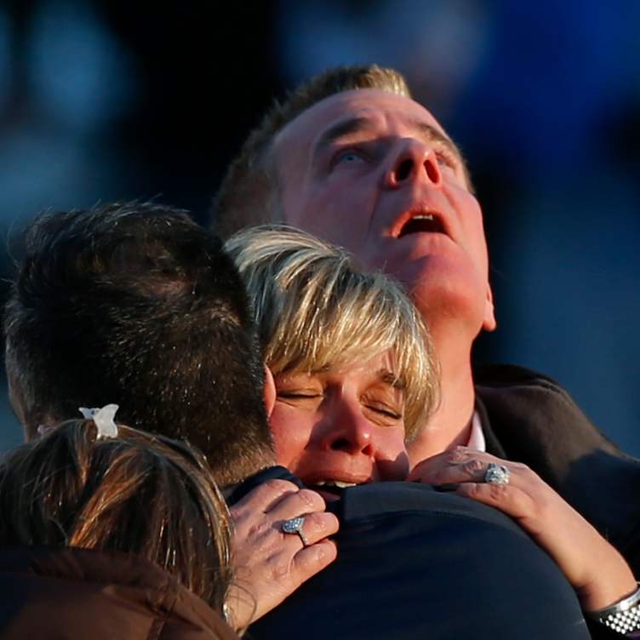
School District Primary Responsibilities
"
1. Students
2. Faculty
3. Parents
4. Community

Slide 42
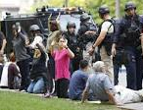
Evacuation once secured.
Accountability
Identification
Investigation
This process can take a considerable amount of time.
EVERYONE must be accounted for, identified and questioned.
Wounded and Deceased.

Slide 43
Discussion
Where will we take the students?
Where will we set up SD Command?
Where will we set-up for media?
Who is doing these things?

Slide 44
WHO
Who is doing all the task that need to be done?
At On-scene Command Post.
Setting up School District operations (Command and Control)
Prepping for reunification
Gathering supplies
Getting buses
Making notifications
Answering calls
Who is their back-up?
Have we trained our faculty to the task we wish them to perform?

Slide 45
How were doing things….
HOW more than the What………
HOW will we transport?
HOW do we communicate?
With each other.
With Responders.
With our partners.
With parents.
HOW do we work as a team?

Slide 46
Decisions
What other information would be helpful?

Slide 47
Are we following our PLAN ?

Slide 48
What does our plan say?

Slide 49
On Scene C-3
Command and Control
Communications
Police
Fire/Medical
School District

Slide 50
ROLES and RESPOSIBILITIES
Law Enforcement.
Fire/Medical.
School ( Can answer questions about the School)
School District (Decision Maker)
School Staff: What level have we trained them to?

Slide 52
Communication Issues
Ad-Hoc Communications System.
Cell Phones:
Pros
Easy
Quiet
Connectivity
Cons
Can create bigger issues.
Texting Family members
Media

Slide 53
Communications
How can you communicate with staff if cellphones are not an option?

Slide 54
After Action - Discussion
What can stay as is? (3) Three Things.
What needs immediate attention? (3) Three Things
What do we need to add?
What are our major Gaps?

Slide 55
Continued Response
We're trying to contain the hysteria within the community," said Pearl School Superintendent William H. Dodson, who each day in the last week and a half has had to quash rumors of bomb threats and other mayhem. "Every time we make some progress, something else happens."

Slide 56
Continued Response
Days:
What's next five days going to be like?
Weeks:
What's the next two weeks going to be like?
Months:
Years:

Slide 57
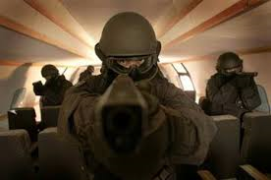
QUESTIONS

