Slide 1

The Elements of Reunification: From “What” to “How”!
Superintendents’ Meeting
Fall 2022

Slide 2
Purpose of a Tabletop (TTX) Exercise
To facilitate discussion of a topic (in this case, your reunification plan).
To walk through a scenario and the courses of action to take.
To help assess your plans and the understanding of your plans.
To determine if your plans and personnel training, etc., need modification.
In preparation of a functional or full-scale exercise.
Consequently, this will not be a true TTX, as we are not testing your individual plans!

Slide 3
Some preliminary questions...
Who will be in over-all charge of an armed intruder event at a school? The superintendent? The principal? The police? Fire? Emergency Medical?
Hint: it is not any school district person!
What is the title of the person in charge?
If you do not know, then you need incident command training. This is offered for free by FEMA and is completely online. It should be mandatory training for all adults employed by the school district.
Reunification Center: who is in charge of what is happening (except for security)?

Slide 4
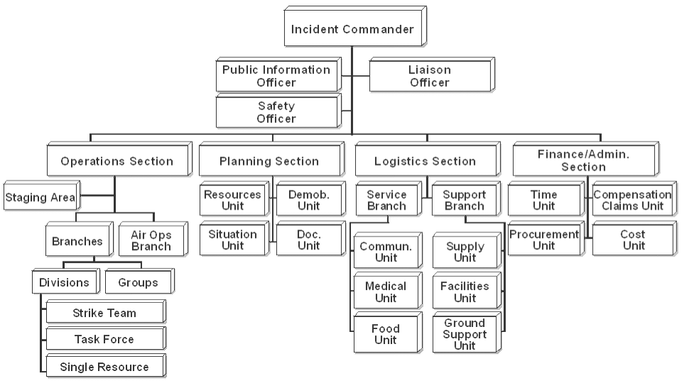

Slide 5

-What events help you to decide to establish a reunification center?
-Communication Considerations
-Transportation Considerations
-Incident Commander at FRC Considerations
-Command Structure at FRC
-Staffing Considerations
-Location Considerations
-Security Considerations
-Media Considerations
-Sustenance Considerations
-Emergency Medical Considerations
-Reunification Process
-Death Notifications
The Considerations For Today…

Slide 6
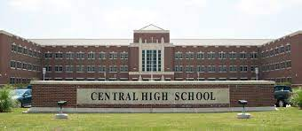
Deciding to Establish a Family Reunification Center…

Slide 7
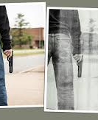
8:35 am.
What sounds like gunshots are heard in the classrooms.
The school has activated its lockdown protocols.
The sole School Resource Officer (SRO) assigned to the school starts to search for the threat.
Two local police officers respond to provide assistance. They immediately go into the school to search for the threat.
The SRO engages what appears to be an armed student. Multiple shots are fired. This student is killed in the engagement, and the SRO is injured.
Shortly thereafter, an armed teacher is mistakenly shot by a responding police officer.
The immediate threat to the school has been neutralized.

Slide 8
Injuries and Death
Students/others killed may be left in place for several hours. This is due to legal necessity (coroner must release the body before it is disturbed) and due to crime scene considerations (photography and evidence collection).
Injured students will be removed immediately from the crime scene (regardless of evidentiary considerations) when the immediate threat is resolved.
Injured may be loaded into ambulances and taken to several different hospitals. Perhaps even out-of-state hospitals. Tracking the injured can be complex.

Slide 9
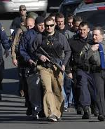
8:45 a.m.
Police have also responded from surrounding communities to assist.
Concerned families have heard about the events from their students (who are now texting) and have begun to show up at the school demanding to pick up their children.
Police do not allow parents on campus. Parents are asking ”why”.
Parents are beginning to talk of “storming” the school to get their children. They are citing “Uvalde.”

Slide 10
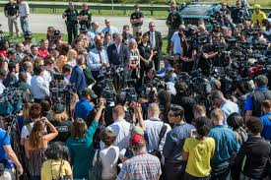
9:05 am
As the parents are notified by the school district about the incident, news media starts to arrive.
The local fire department has fully responded as well as ambulances.
A perimeter has begun to be established around the school by responding law enforcement officers (LEO’s).
Many LEOs, fire department officials and ambulance personnel are seen entering the school by the parents.
Police are now called to a nearby residence with reports of casualties.

Slide 11
1) What are the consequences of designating the school a crime scene?
2) Besides being students, what else could they be now?
3) Besides being teachers/administrators, what else could they be now?
4) Are you confident that all students/teachers/administrators are accounted for?
5) The shooter is dead. Is the school safe now to occupy?
6) With its multitude of entrances and exits, parking facilities, and out-buildings, are you confident that all parents will respect the order to not enter the school? Why would they ignore such an order? What is the consequence of an armed parent in the hallways of the school? Remember the teacher?
Planning and Operations Questions
Factors to Consider To Establish a Family Reunification Center (FRC)

Slide 12
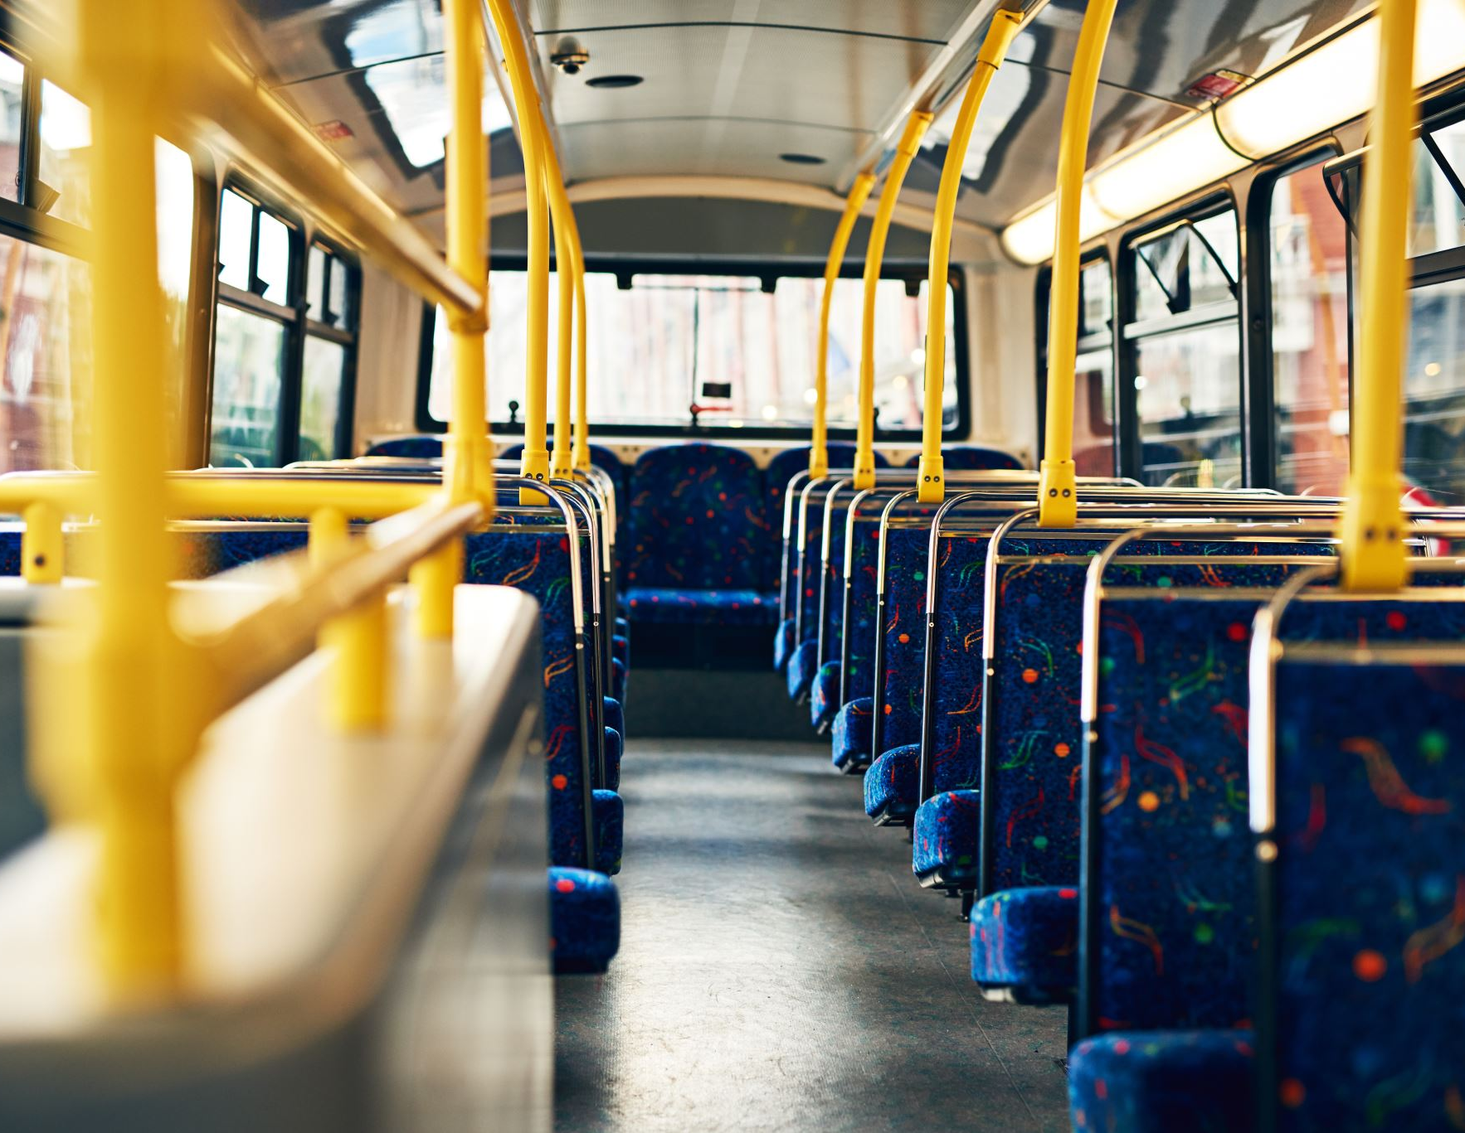
Order of Your Problems:
1) Decision to Establish the FRC
2) Standing up the FRC (including Staffing & Security)
3) Notifying Parents/Community
4) Securing Buses For FRC
5) Loading the Students on Buses & Safe Transport of Students
6) The FRC Reunification Process
7) Media
8) Closing the FRC

Slide 13
-Is it big enough to hold the students and the parents for several hours?
-Are the sufficient facilities at the FRC? Bathrooms? Kitchen? Interview Rooms? Death Notification Rooms?
-Is there easy access to the facility?
-Can students be dropped off and then enter the facility outside the view of parents?
-Is there sufficient parking for the parents?
-Is there sufficient space for emergency vehicles, to include ambulances?
-Can parents and students be adequately separated until PLANNED reunification?
-Is there access to WiFi? Communications?
-Is there a space for a command post?
-Sufficient tables, chairs, food & water?
Planning Questions
Some Factors To Consider in Finding a Family Reunification Center

Slide 14
SUGGESTED STEPS TO OPEN THE FRC.
1. Superintendent and Incident Commander (Police Chief) at Main Command Post (MCP) agree to activate FRC.
Consider security needs (for bus transport; for site security)
Consider other logistics needs (buses, medical, food & water support): who to alert? Call list!
2. Asst. Superintendent: contact FRC location and alert them of impending reunification process
Ensure the facility is now open and accessible: prepositioned materials
Asst. Superintendent leaves MCP for FRC.
3. Asst. Superintendent: Establish incident command (IC) structure at FRC
Pull out IC chart and alert key command staff of FRC establishment
Ensure MCP has copy of FRC IC structure
4. MCP PIO: Issue public announcement of FRC establishment/location. Best to make this announcement when key personnel/positions are in place at FRC.

Slide 15
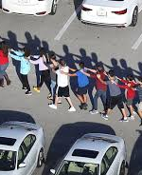
9:30 am
The decision is made to open a family reunification center (FRC): The school is a crime scene; there are potential witnesses among the students; the school is otherwise unsafe; and parental actions are increasingly difficult to control.
Advise parents that information on where to obtain children is forthcoming/FRC.
At the school, LEOs go from classroom to classroom, using obtained keys, and enters each classroom to ensure there are no threats inside.
After a room is cleared, the students inside are gathered and led single file down the hall to presumed waiting school bus.

Slide 16
Incident Command Structure:
-Command Staff (IC’dr/Unified)
-Finance
-Logistics
-Operations
-Planning
Emergency Operations Center
(Main Command Post)
(Joint Operations Center)
-Incident/Unified Commander(s) Structure
Staging Area
Joint Information Center
High School
Incident Command Post-1
(Forward Command Post-1)
(Tactical Command Post-1)
-Elements of Incident Command Structure
Family Reunification Center
Incident Command Post-2
(Forward Command Post-2)
(Tactical Command Post-2)
-Elements of Incident/Unified Command Structure
Shooter’s Residence
Incident Command Post-3
(Forward Command Post-3)
(Tactical Command Post-3)
-Elements of Incident Command Structure

Slide 17
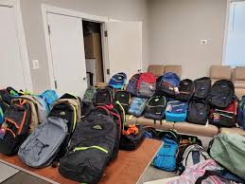
Operations Questions…
What will students be allowed to carry with them to the FRC? Book bags? Purses? Cell phones? Bulky coats in winter?
If you had deceased students in the common areas, would you change what the classroom students are allowed to bring with them?
What is happening at the other schools in your district? Are parents allowed to pick up students there?
Will you have enough buses to take those ”other school” students home, and still provide adequate assistance in moving students to the reunification center?

Slide 18

-There are 1150 students at the high school.
-There are 70 teachers and staff
-There are 6 other schools (7 total) in the school district
-There are a total of 70 buses in the district.
-The buses must travel 4 miles (one-way) through heavily populated areas with normally busy streets to reach the FRC.
Logistics and Operations Considerations
Some Transportation Considerations Related To This Event

Slide 19

-How many buses do you have in your school district? Where could you get more?
-Search students before entering the bus? What could happen if you don’t search them?
-Is security inside each bus therefore necessary?
-Will the buses be escorted to FRC? Why?
-How long will it take for the bus to drive the 4 miles to the FRC, unload students, and drive back? Will normal traffic and panicked parents be a factor?
-Consequently, how long will it take to empty the school of students/teachers/administrators?
-Will there be innocent students hiding at the school and unwilling to come out in the open?
Questions: Factors to Consider Concerning Transportation to the FRC
Logistics, Operations and Planning Questions

Slide 20

INSIDE THE FAMILY REUNIFICATION CENTER (FRC) PROCESS…

Slide 21
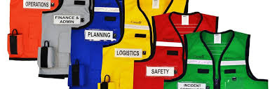
Post-Decision To Establish The FRC
What entity will be in charge at the FRC? School District? Police?
Consequently, who will be incident commander at the FRC? What is the role of the incident commander?
What will be the limits of his/her authority, if any?
What steps should be taken after the decision to open the FRC is made?
Operations Questions

Slide 22
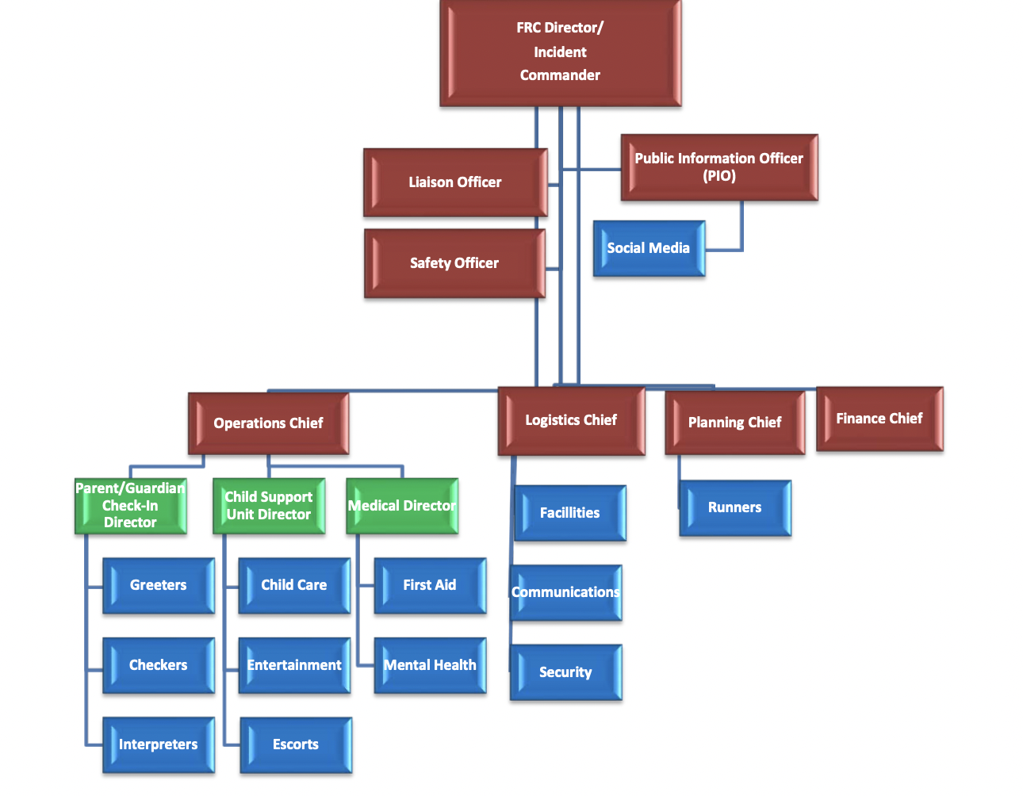
Example of Incident Command Chart For FRC
Source: I Love You Guys Foundation

Slide 23
Some Questions About Incident Command At The FRC
Why is an Assistant Superintendent a logical choice for IC at the FRC? Anyone else?
Is it a good idea to have a note taker/scribe assigned full time to the IC/Asst. Superintendent? What about the Superintendent?
Why not the Superintendent?
Why are the police not in over-all charge?
What are the police in charge of at the FRC?
Can you release information to the public via a press release, etc., from the FRC?
Who would be your Operations, Logistics, Planning, and Finance Chiefs? Why them?
Who would be your Directors? Why them?
How will the personnel communicate with each other at the FRC?

Slide 24
All Communications To the Public or Press Must Be Pre-Approved By the Command Post/Police Chief!!!
Remember…

Slide 25

Note: The Following Process Is Just One Possibility.
You Must Work Within Your Community To Determine The Best Process For Family Reunification.
Partial Source For Following Process: I Love You Guys Foundation.
Note: There are several other sources for this information,
Including the MS DHS.

Slide 26

POSITIONS AT THE FRC…

Slide 27
FRC Staff (School District Personnel)
Incident Commander: Assistant Superintendent
Administrators: Assistant Principals
Security: Law Enforcement Officer
Greeters: greets incoming parents and students at parking lot and parent check in area
Checkers: verifies information from a static location/tables
Runners: moves information between areas/branches
Translators: parent check in area/branch
Escorts: Escorts parents and students in facility
Source: I Love You Guys Foundation

Slide 28
FRC Facility
Areas
Parent Check In Area
Parent Waiting Area
Student Check In Area
Reunification Area
Critical Notification Area
Medical Areas
Food Service Areas
Red Cross/Salvation Army
Counseling Areas
Security Check Points
Parent Parking
Ambulance Parking
Police Parking
FRC Forward Command Post

Slide 29
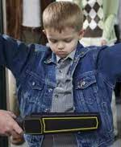
9:45 a.m.
Students arrive at the FRC.
As they exit the buses, they are searched (again) by police.
Students and teachers that left the school classroom together are advised to stay together at the FRC.
Students are divided by grade level as well, when possible.
Students are texting their parents of their arrival at the FRC.
Students advise teachers that their parents want to meet them outside immediately.
One student panics and cries uncontrollably. Another student advises he has diabetes and needs some food.
All students begin to complain about thirst and hunger.
Students begin to want to socialize with other students not in their classroom group.

Slide 30
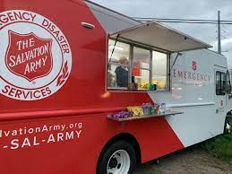
Logistics & Finance Questions…
Students need medical and counseling attention, food and water. How do you prioritize these issues? Who makes those decisions?
Who obtains these items? From Where? How are they paid for?

Slide 31

9:50 am
Parents begin to arrive at the FRC.
Greeters meet the first parents in the parking lot and direct them to the parent check-in tables.
Parent check-in tables can be inside or outside, depending on weather, etc.
Parents are lined up behind a table and in front of a range of alphabet letters that match their last name. A-G; H-N, etc.
Checkers staff the check in tables.
Parents are handed clipboards by Greeters with check in cards to be filled out while in line. They are advised proper ID is necessary.

Slide 32
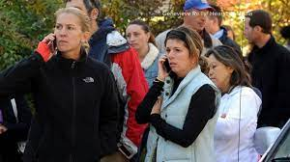
Operations Questions…
What problems would you anticipate with the arrival of parents?
Who would be the best persons to greet the parents?
Where will you need security at FRC?
Do you release children to parents without identification? If not, why not? If so, under what conditions?
What languages are spoken in your school district?

Slide 33
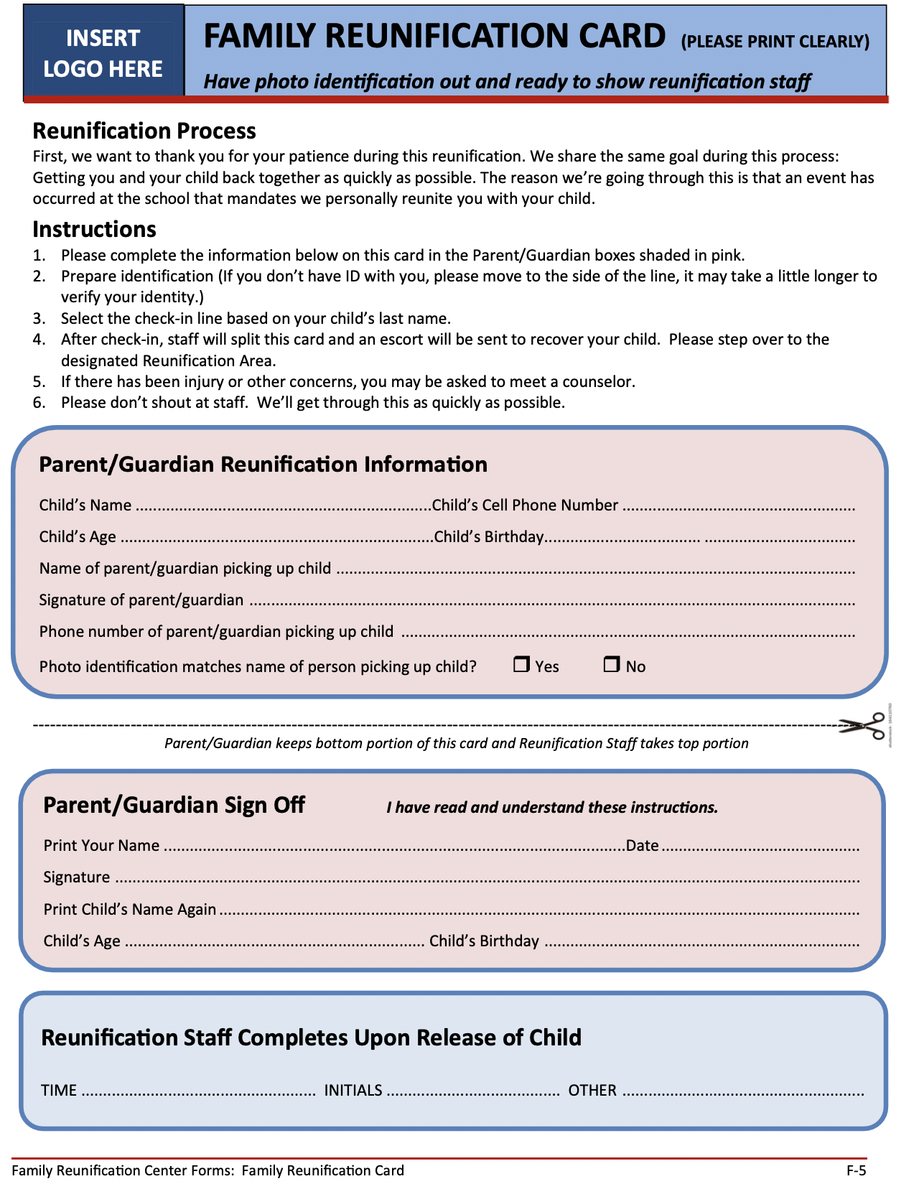
10:00 a.m.
Parents' forms are verified & separated.
Parent & top half of form go to a Parent Waiting Area.
Bottom half of form goes with Runner to the Student Waiting Area.
Student identified by card. Parents information on card confirmed by student.
Student is released from Student Waiting Area to an Escort who takes student to Reunification Area with the bottom half of card.
Source: I Love You Guys Foundation.

Slide 34
Planning & Operations Questions…
How will you verify that a parent can receive a student? Restraining Orders, lack of custody rights, etc.
What happens if you discover a parent is not to have access to a student?
Who releases the student from the Student Waiting Area?
How is this recorded?
Hard copy or digital for the forms?

Slide 35
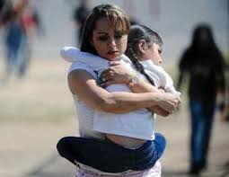
10:25 a.m.
Student waits in Reunification Area for parent.
Escort takes bottom half of card to Parent Waiting Area and identifies parent(s) and verifies information on both cards.
Escort, in possession of both cards, escorts the parents to the Reunification Area.
Parents and student(s) reunified.

Slide 36
Operations Questions…
What information will the parents require from officials assigned to the Parent Waiting Area?
01
Why is it critical to notify parents and have them escorted to the Reunification Center look routine?
02
Reunification will be emotional. What issues can this cause?
03

Slide 37

10:35 a.m. Till Finish…
Parent and student leave thumbprint on bottom card. Both sign the card.
Both cards stapled together and held by Administrator.
Student(s) and parents photographed together by Checker.
Information recorded on a Child Accountability Roster (or other form) by Checker.
Parent and student leave the building/Reunification Area for parking lot.
Parents are advised to leave the premise as soon as possible.
Police advise the parents to leave the premise as soon as possible.
MCP advised when all students reunified with parents.

Slide 38
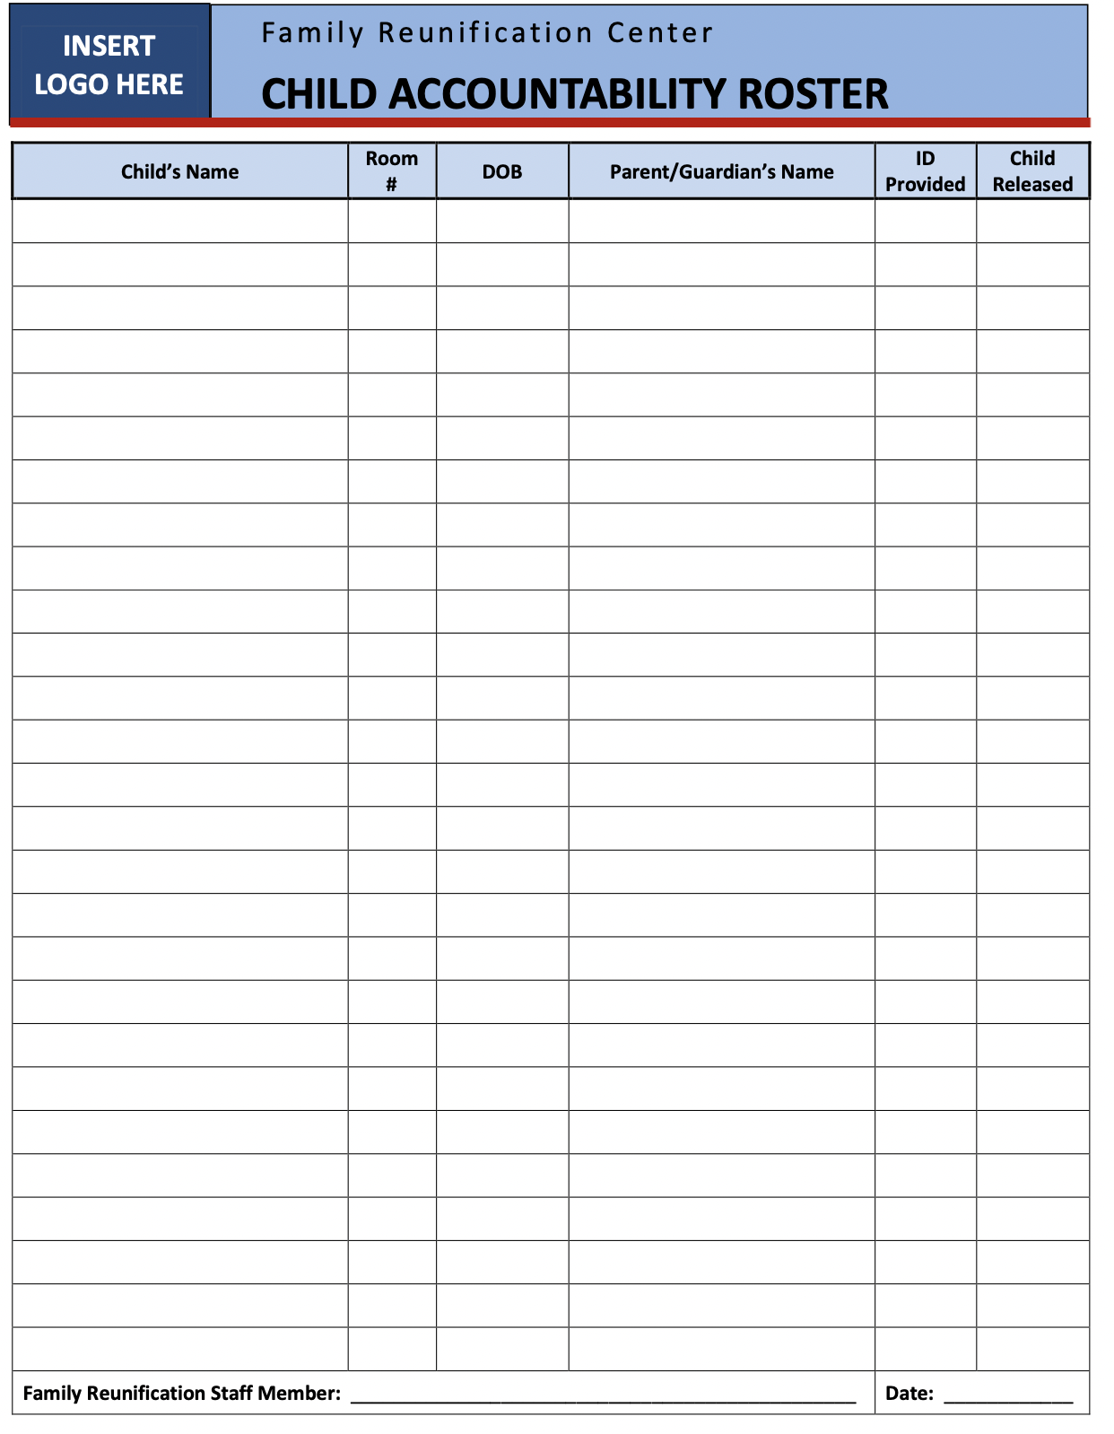
Source: I Love You Guys Foundation

Slide 39

Operations Questions…
What if a parent objects to leaving a fingerprint or being photographed?
What happens if no parent shows up to claim a student?
Must you follow a similar reunification process for all emergency situations?

Slide 40
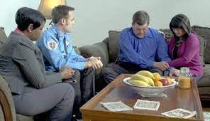
Death Notifications
MCP advised of beginning of process.
Parents retrieved by Escort from Parent Waiting area.
Escort takes parents to an isolated room/area. Ideal to have area access to waiting emergency vehicles.
Parents greeted by school superintendent or assistant superintendent.
Clergy, police official, and medical personnel in room on standby.
Parents are escorted from premise by police and police security offered for their residence for a specified time period.
No press personnel at the FRC.
MCP advised when all notifications completed.

Slide 41
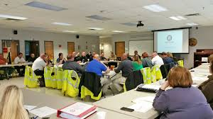
Superintendent (include surrounding district(s) Superintendent)
Assistant Superintendent(s)
Principals
Assistant Principals
School Counselors
Select Teachers
School Transportation Director
FRC Personnel (designated Greeters, Checkers, etc.)
Police/Sheriff
Fire
County Emergency Management Personnel
MS Office of Homeland Security
Ambulance Personnel
Management from the FRC Location
School Board Member
School Board Attorney
Who Should Attend Your FRC Tabletop Exercise in Your School District?

Slide 42

Thank you!

